Slide 1

強盛新股份有限公司
CHYANG Sheng TEXING co., ltd
2025 Investor Conference
2025.12.24.
1463 (TWSE)

Slide 2
Safe Harbor Notice
This presentation has been prepared by Chyang Sheng Texing Co., Ltd. (the “Company”) solely for corporate communication. It does not constitute an offer to sell or a solicitation to purchase any securities of the Company.
The information herein is a summary and may be incomplete. No representation or warranty, express or implied, is made as to the fairness, accuracy, or completeness of the information. The Company assumes no responsibility for any reliance placed on this presentation.
No part of this presentation may be reproduced or redistributed without prior written consent.

Slide 3
Agenda
Company Profile
Industry Overview
Main Products
Financial Results

Slide 4
Company Profile
Company Name: Chyang Sheng Texing Co., Ltd.
Established: October 1983
Paid-in Capital: NT$1.73 billion
Employees: 116
Chairman: Mr. Hon Kit Shing
General Manager / CEO: Mr. Jeffrey Shee Chee Cheung
IPO: Listed on TWSE in 1996 (1463.TW)Core
Business: Commission dyeing and finishing of woven cellulosic and synthetic fabrics.

Slide 5
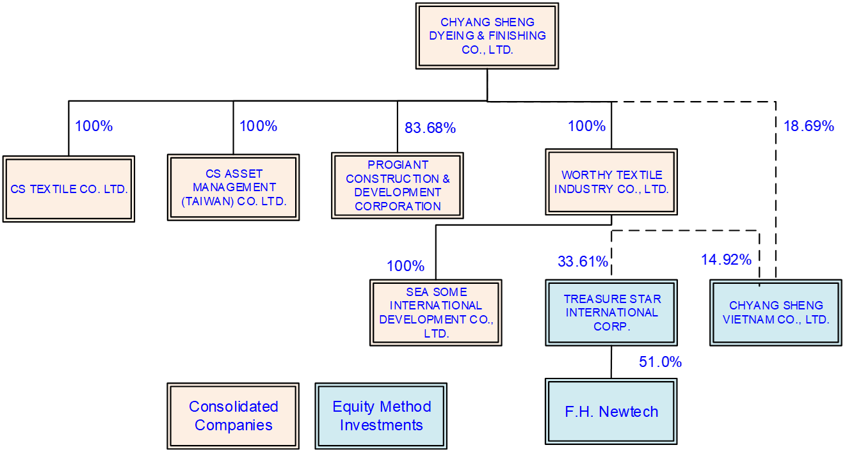
Group Structure

Slide 6
Company Milestones6
1983
Birth of Chyang Sheng Dyeing & Finishing Co., Ltd
1984
Commissioning of The Continuous Open-width Dyeing Range for Cellulosic Fabrics
1993
Commissioned Cold Pad Batch (CPB) & Air Flow Exhaust Dyeing Machines for Synthetic and Cellulosic Fabrics
1996
The Stocks of the Company Were Officially Listed on the Taiwan Stock Exchange (“TWSE”)
1997
PROGIANT CONSTRUCTION & DEVELOPMENT CORPORATION were Established for Construction Business
1998
Acquired More Than 50% Shares of CHYANG SHENG VIETNAM CO., Ltd. (CSVN) for Commissioning Printing Business In Vietnam.
2012
Treasure Star International Corp. (TSI) were Established for International Trading Business.
2014
Strategically Increase CSVN & TSI’s Capitals to Alliances and Reduce Shareholding Ratios Under 50%. CSVN & TSI were No Longer Incorporated into Consolidated Statements
2017
Acqiured the Swiss Bluesign@ technology certification, become the System Partner of the Bluesign Organization.

Slide 7
Company Profile
Milestones
2019
accomplished the Science and Technology Research and Development Project of the Ministry of Economic Affairs –”Woven Synthetic Fabrics Wisdom & Optimization Production Project“
2020
Complete the new energy system, replace coal-fired boilers with medium-pressure steam, move towards the goal of sustainable environmental protection, energy conservation and reduces CO₂ EMISSIONs and implement CSR.
2021
Obtained the Swiss Bluesign@ technology certification, meeting the highest requirements for ecological environmental protection, health and safety for both products and processes.
2022
In order to implement corporate social responsibility and protect the human rights of foreign employees, the “Zero Fee” policy for foreign labor employment has been implemented. By revising labor recruitment procedures, foreign migrant workers are prevented from being exposed to the risk of human trafficking and forced labor.
2023
Obtained the OEKO TEX@ standard 100 certification for ecological textiles and passed the product hazardous substance inspection. The product is harmless to humans and ecology.
2024
Stop short fiber production line and fully develop long fiber products
2024
Changed company’s name to CHYANG Sheng TEXING co., ltd
2025
In 2025, Mr. Hon Kit Shing was elected Chairman. Under the new leadership, the Company initiated an organizational restructuring to transform into Chyang Sheng Investment Holding Co., Ltd.
The spinning & dyeing business and the real estate management operations were spun off into independent subsidiaries to enhance competitiveness and operational efficiency.
The spin-off plan was approved at the EGM in December 2025.

Slide 8
Industry Overview
Textile industry chain

Slide 9
Main Products
Production line and processing product classification
Production line and processing product classification
Filament-fabric batch dye: Polyester, Nylon & other synthetic fibers
Specialist
CPB, fibrillation, weight reduction, moss/peach skin,
mite repellent, flame retardant, oil/water repellent,
soil-release, wicking, easy-care/wrinkle-free, fatigue-look,
brushing, sanding, suede finishing.

Slide 10
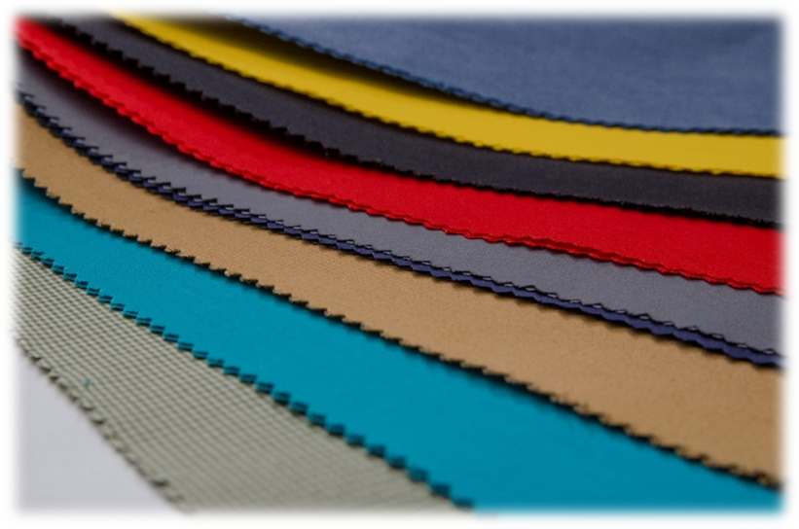
Main products (by materials)
(Fillament)
Polyester 100%、Nylon 100%、N＊T、PBT、PTT …
(Cross Weaved)
C＊N、N＊C、C＊T、T＊C、R＊T、R＊L
N*T*CD
(Conjugate yarn)
(Micro Fiber)
(One-Way, Two-Way Stretch)
Environmentally friendly materials

Slide 11
Main Products (by funtionals)
Functional finishing
Wicking & Sanitation
Antibacterial, deodorant & UV-cut compound functional finishing
Anti-mosquito, aromatic & moisturizing skin care by microcapsules finishing
Introduction and Application of Nanometer Processing Aid
C6 environment-friendly water-repellent / oil-repellent finishing
Fluoride-free water-repellent finishing

Slide 12
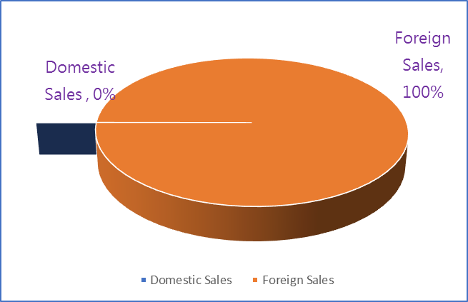
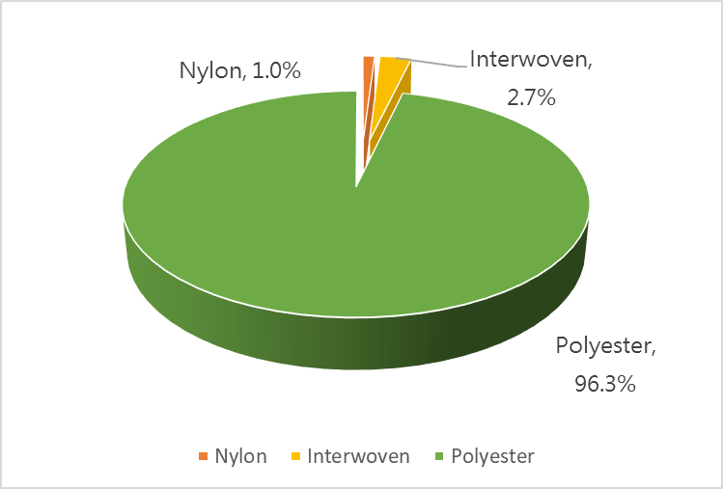
Product category information
Ratio of material type and domestic and foreign sales

Slide 13
Financial Results
Consolidated Statements of Comprehensive Income

Slide 14
Financial Results
Segment information - Revenue and Profit in %
2025Q1~Q3
2024Q1~Q3
2024

Slide 15
Financial Results
Performance - Major Financial Indices
Unit：NTD Thousand

Slide 16
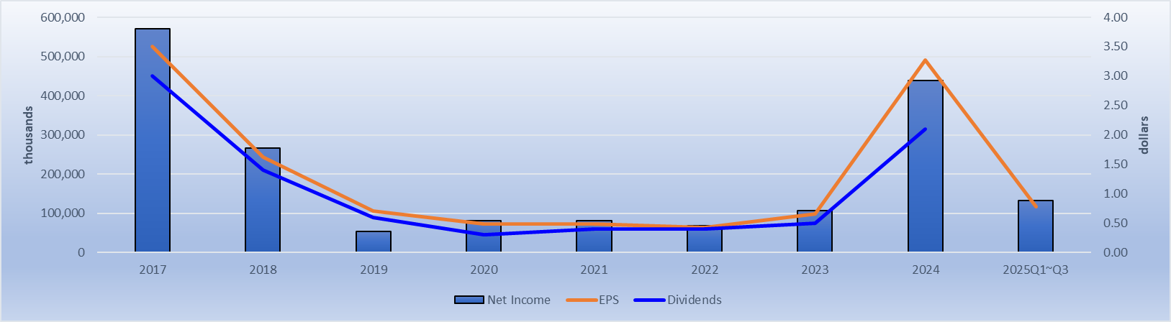
Financial Results
Dividends in the Last 8 Years

Slide 17
THANK YOU FOR YOUR ATTENTION

