Slide 1

強盛新股份有限公司
CHYANG Sheng TEXING co., ltd
2024 Investor Conference
2024.12.10 .
1463 (TWSE)

Slide 2
Safe Harbor Notice
This presentation is prepared by CHYANG Sheng dyeing & finishing co., ltd (the “Company”) and is solely for the purpose of corporate communication and general reference only. The presentation is not intended as an offer to sell, or to solicit an offer to buy or form any basis of investment decision for any class of securities of the Company in any jurisdiction. All such information should not be used or relied on without professional advice. The presentation is a brief summary in nature and does not purport to be a complete description of the Company, its business, its current or historical operating results or its future prospects.
This presentation is provided without any warranty or representation of any kind, either expressed or implied. The Company specifically disclaims all responsibilities in respect of any use or reliance of any information, whether financial or otherwise, contained in this presentation. Neither this presentation nor any of its contents may be reproduced to a third party without the prior written consent of the Company.

Slide 3
Agenda
Company Profile
Industry Overview
Main Products
Financial Results

Slide 4
Company Profile
Company Name Chyang Sheng Texing Co., Ltd
Estabilishment 1983.10
Capital NTD 1.73 billions
Payroll 151
Chairman Mr. Chen Jen Fa
President David Sun
IPO Listed in TWSE , 1996 (1463.tw)
Products Commission Dyeing &Finishing of full-range
Woven Cellulosic & synthetic Fabrics

Slide 5
Group Structure

Slide 6
Company Milestones6
  1983 Birth of Chyang Sheng Dyeing & Finishing Co., Ltd
  1984 Commissioning of The Continuous Open-width Dyeing Range for Cellulosic Fabrics
  1993 Commissioned Cold Pad Batch (CPB) & Air Flow Exhaust Dyeing Machines for Synthetic and Cellulosic Fabrics
  1996 The Stocks of the Company Were Officially Listed on the Taiwan Stock Exchange (“TWSE”)
  1997 PROGIANT CONSTRUCTION & DEVELOPMENT CORPORATION were Established for Construction Business
  1998 Acquired More Than 50% Shares of CHYANG SHENG VIETNAM CO., Ltd. (CSVN) for Commissioning Printing Business In Vietnam.
  2012 Treasure Star International Corp. (TSI) were Established for International Trading Business.
  2014 Strategically Increase CSVN & TSI’s Capitals to Alliances and Reduce Shareholding Ratios Under 50%. CSVN & TSI were No Longer Incorporated into Consolidated Statements
  2017 Accqiured the Swiss Bluesign@ technology certification, become the System Partner of the Bluesign Orgnization..

Slide 7
Company Profile
Company Milestones
  2019 accomplished the Science and Technology Research and Development Project of
  the Ministry of Economic Affairs - “Woven Synthetic Fabrics Wisdom & Optimization Production Project“
  2020 Complete the new energy system, replace coal-fired boilers with medium-pressure steam, move towards the goal of sustainable environmental protection, energy conservation and reduces CO₂ EMISSIONs, and actually implement cSR.
  2021 Obtained the Swiss Bluesign@ technology certification, meeting the highest
  requirements for ecological environmental protection, health and safety for both
  products and processes.
  2022 In order to implement corporate social responsibility and protect the human rights
  of foreign employees, the "Zero Fee" policy for foreign labor employment has been
  implemented. By revising labor recruitment procedures, foreign migrant workers are
  prevented from being exposed to the risk of human trafficking and forced labor.
  2023 Obtained the OEKO TEX@ standard 100 certification for ecological textiles and
  passed the product hazardous substance inspection. The product is harmless to
  humans and ecology.
  2023 Participated in the investment and establishment of NICSINGTEX Co., Ltd. To
  undertake Nylon orders.
  2024 Stop short fiber production line and fully develop long fiber products
  2024 Changed company’s name to CHYANG Sheng TEXING co., ltd

Slide 8
Industry Overview
Textile industry chain

Slide 9
Main Products
  Production line and processing product classification
  Production line and processing product classification
  Filament-fabric batch dye: Polyester, Nylon & other synthetic fibers
Specialist
  CPB, fibrillation, weight reduction, moss/peach skin,
  mite repepellent, flame retardant, oil/water repellent,
  soil-release, wicking, easy-care/wrinkle-free, fatigue-look,
  brushing, sanding, suede finishing.

Slide 10
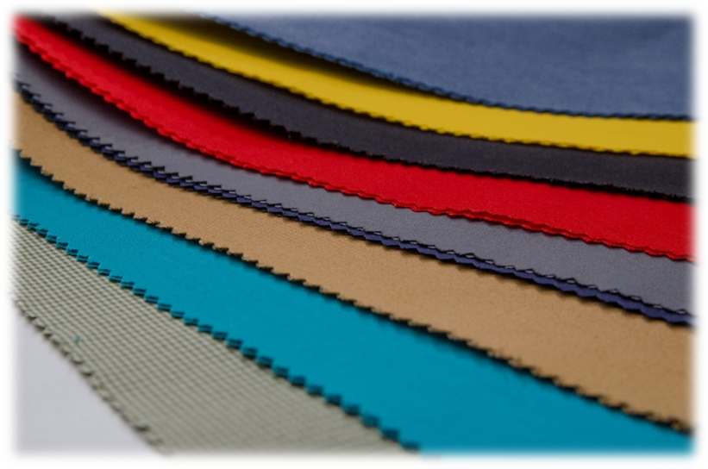
Main products (by materials)
(Fillament)
Polyester 100%、Nylon 100%、N＊T、PBT、PTT …
(Cross Weaved)
C＊N、N＊C、C＊T、T＊C、R＊T、R＊L
N*T*CD
(Conjugate yarn)
(Micro Fiber)
(One-Way, Two-Way Stretch)
Environmentally friendly materials

Slide 11
Main Products (by funtionals)
Functional finishing
  Wicking & Sanitation
  Antibacterial, deodorant & UV-cut compound functional finishing
  Anti-mosquito, aromatic & moisturizing skin care by microcapsules finishing
  Introduction and Application of Nanometer Processing Aid
  C6 environment-friendly water-repellent / oil-repellent finishing
  Fluoride-free water-repellent finishing

Slide 12
Product category information
Ratio of material type and domestic and foreign sales

Slide 13
Product category information
Product category information

Slide 14
Financial Results
Consolidated Statements of Comprehensive Income

Slide 15
Financial Results
Segment information - Revenue and Profit in %
2024Q1~Q3
2023Q1~Q3
2023

Slide 16
Financial Results
Performance - Major Financial Indices
Unit：NTD Thousand

Slide 17
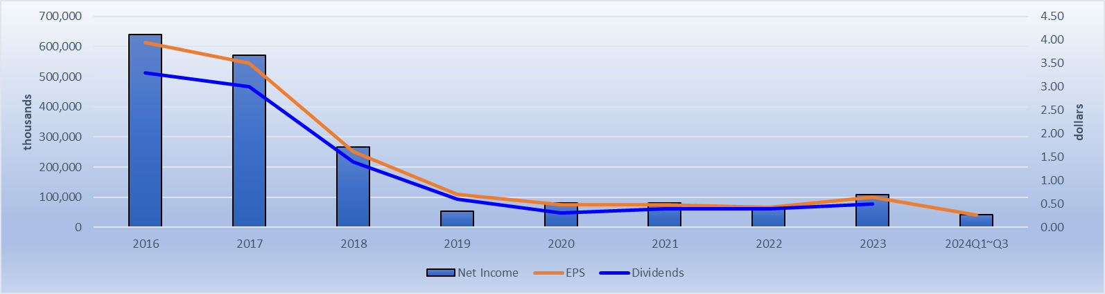
Financial Results
Latest-8-Years Dividends

Slide 18
THANK YOU FOR YOUR ATTENTION

